Slide 1
Network on
4 chord GUITAR
Kunal Kulkarni
Zhiqi Ma
Judy Zhu

Slide 2
01
Introduction

Slide 3
Music Information Retrieval (MIR)
In recent years, MIR — finding, organizing, and suggesting music from large digital collections — has become a significant area of research.
A big challenge in MIR is figuring out how to measure the similarity between different pieces of music.
Our project is based on the idea that songs with melodies that sound similar often have similar chord progressions as well.
It seems that no existing works on MIR have attempted to use network theory to model chord progressions and then compare chord similarity, so our goal is to compare the melodies of guitar songs by looking at the network of chords used in these songs.

Slide 4
What We Will Do?
We first select 6 songs consisting of only 4 guitar chords -- C, G, F, Am -- and create the chord sequence for each song.
We then formulate a network where each node is a 3-chord sequence like CCG and an edge represents the chord progression (e.g.: in the chord sequence CCGF, there is an edge from CCG to CGF).
Based on the network, we conduct several similarity comparison tasks between songs such as calculating the node centrality and using the earth movers metric, with corresponding visualizations, analysis, and discussions.
Even beyond that, we also apply random walk to generate a chord sequence and then turn it into a piece of music melody to test the effectiveness of our model.

Slide 5
02
Methodology
Results & Analysis

Slide 6
Data Selection & Processing
Four specific chords (C, Am, F, G)
All Too Well by Taylor Swift
Baby by Justin Bieber
Hey Soul Sister by Train
Riptide by Vance Joy
Story of My Life by One Direction
Yellow by Coldplay
Represent the chord progression for each song as a string of chords with the format like “CGFCCGFC...CGFCGFCGF”
Resulting in 64 3 chord sequence as nodes
Chord progression as edges
[
[

Slide 7
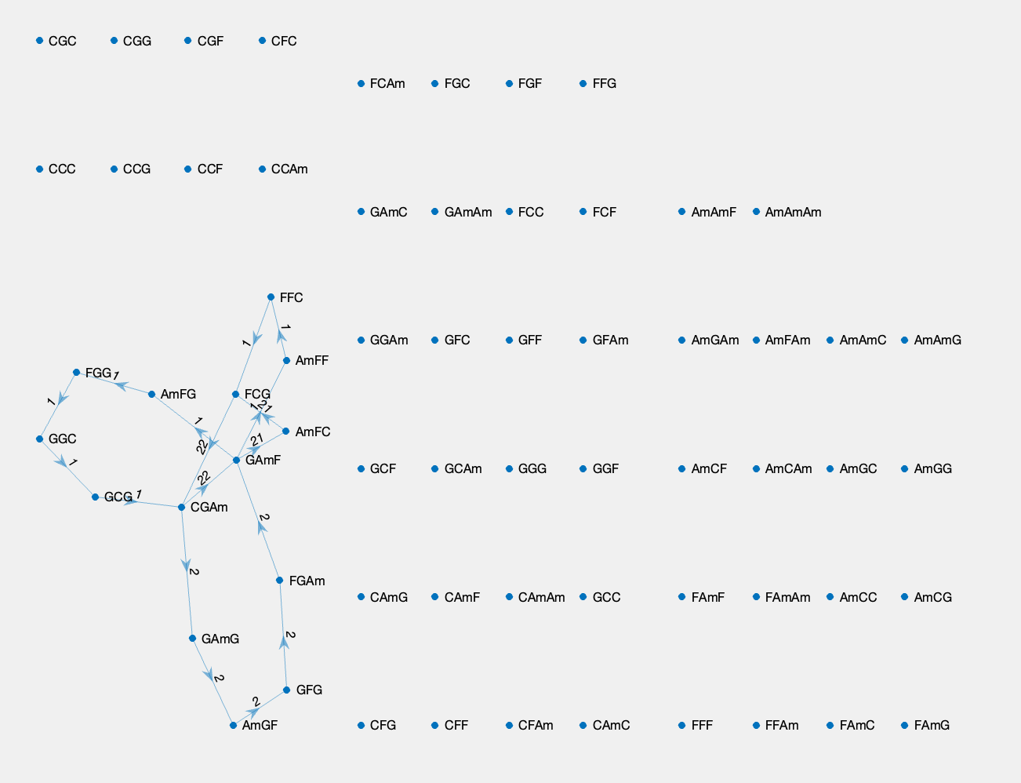
Network - All Too Well

Slide 8
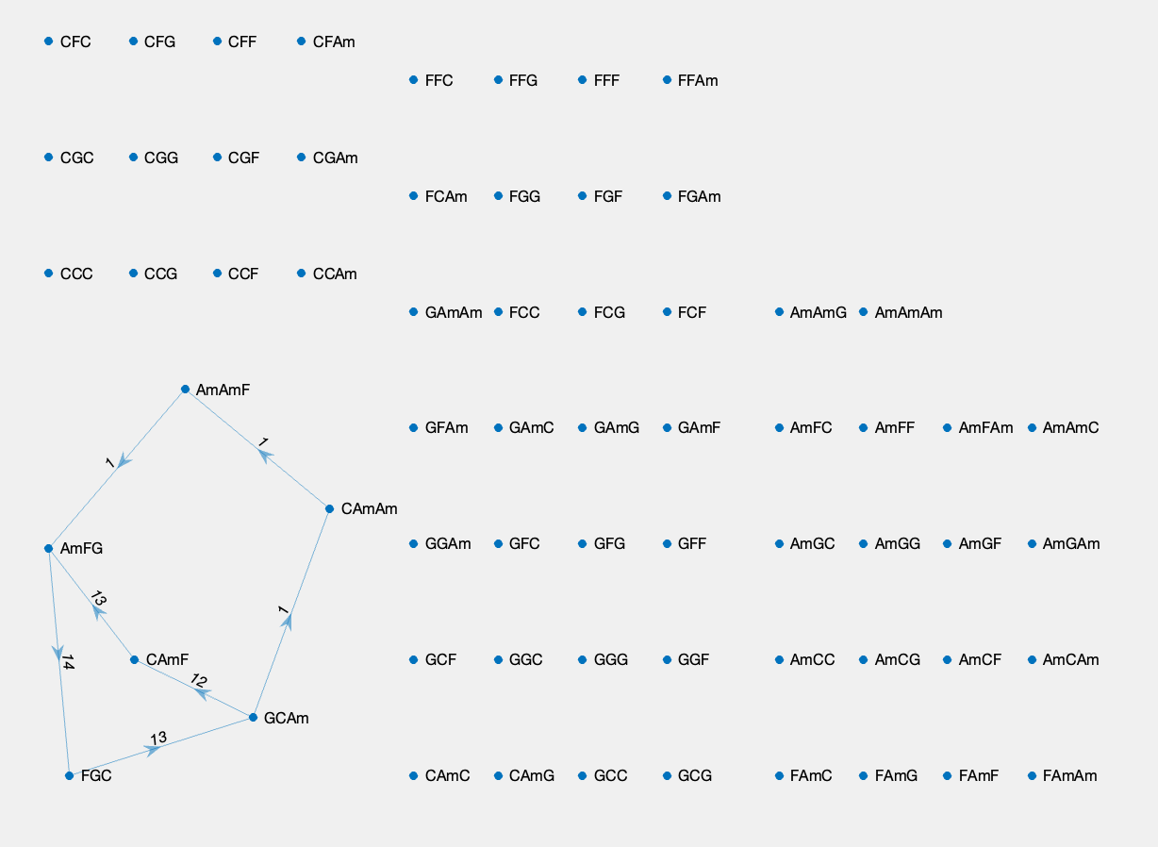
Network - Baby

Slide 9
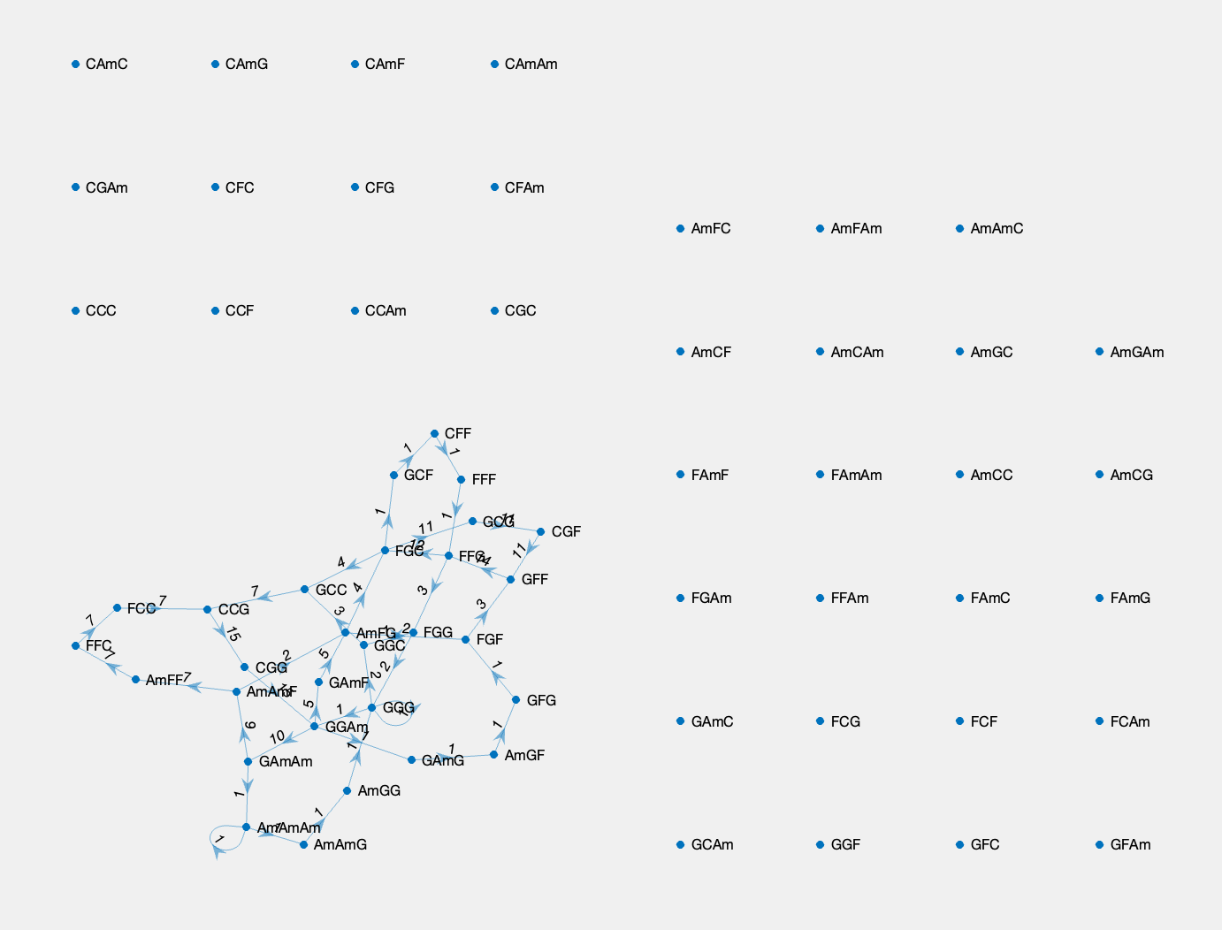
Network - Hey Soul Sister

Slide 10
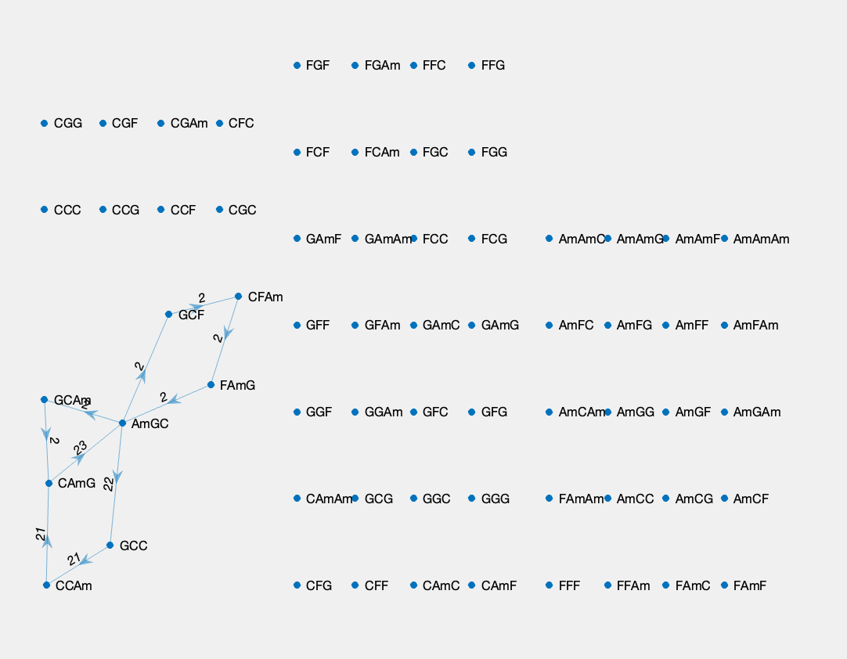
Network - Riptide

Slide 11
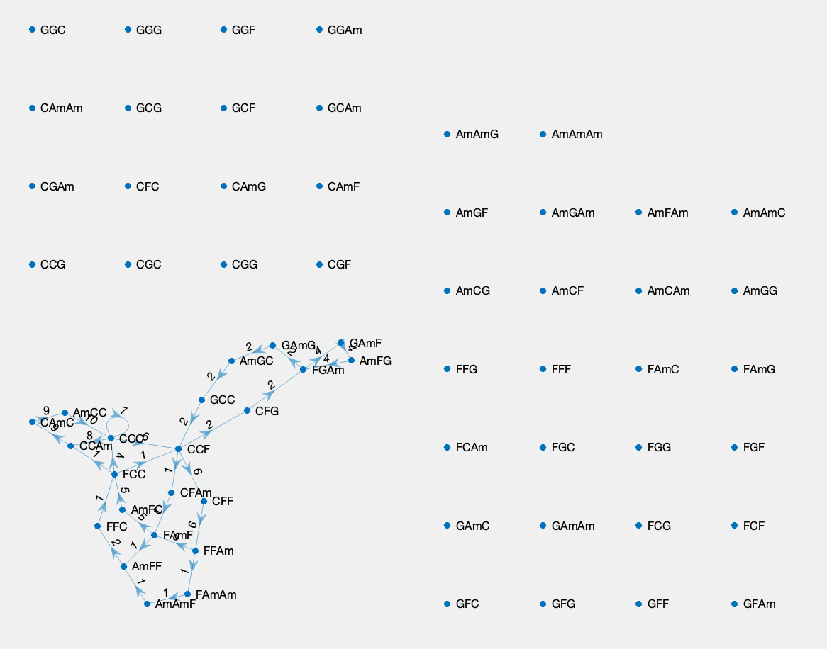
Network - Story of My Life

Slide 12
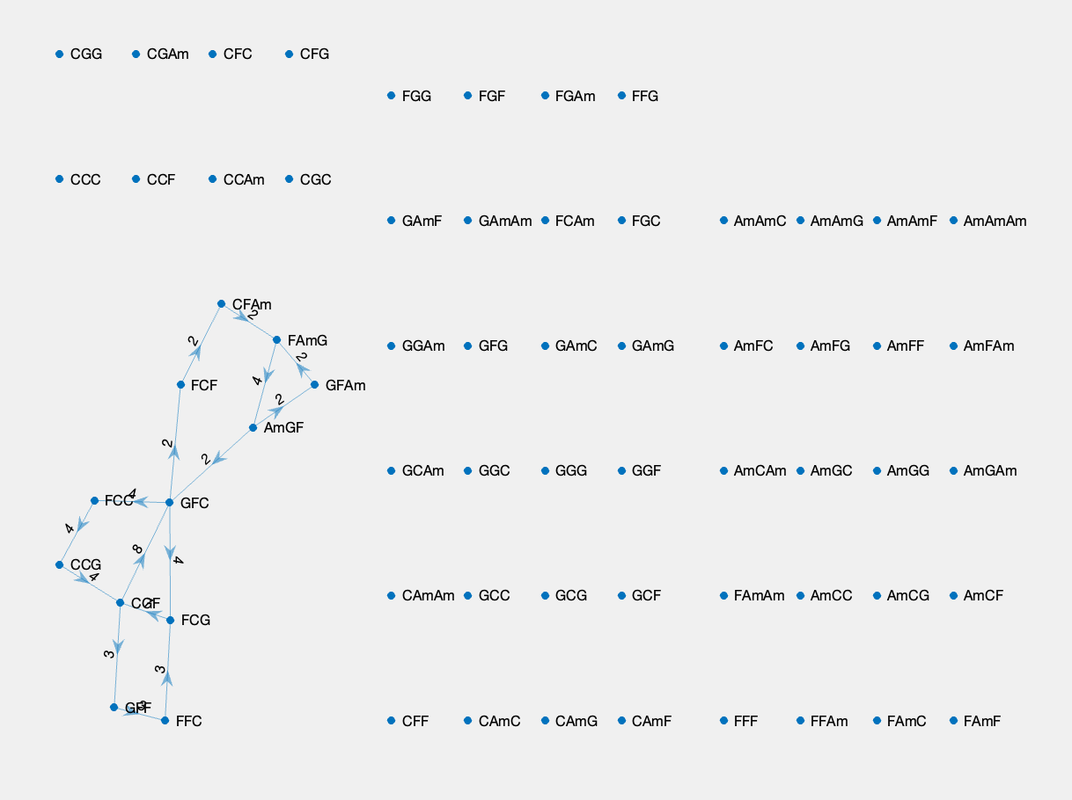
Network - Yellow

Slide 13
Network Similarity Comparison
01
02
03
1ST METHOD
2ND METHOD
3RD METHOD
Eigenvalue Centrality and Frequency Analysis
Earth Mover Distance
Matrix Multiplication

Slide 14
Eigenvalue Centrality & Frequency Analysis
Definition: Eigenvalue Centrality ranks eigenvectors to assess node significance in a network.
Tools: Utilizes pandas for data conversion and numpy for matrix computation.
Process:
Construct a dataframe and extract chord combinations.
Eliminate chord strings for numerical computation.
Convert dataframe to numeric type and then to numpy array.
Compute eigenvalues and eigenvectors.
Identify maximum eigenvalues to rank associated eigenvectors.
Use these ranked eigenvectors to rank the chord strings associated with them

Slide 15
Eigenvalue Centrality & Frequency Analysis
Definition: Frequency Analysis ranks nodes based on total out degrees.
Tools: Utilizes pandas for conversion and numpy for efficient computation.
Process:
Capture chord information from dataset.
Convert data into numpy array.
Compute row sums efficiently using numpy's sum function.
Rank row sums based on indices using argsort feature.

Slide 16
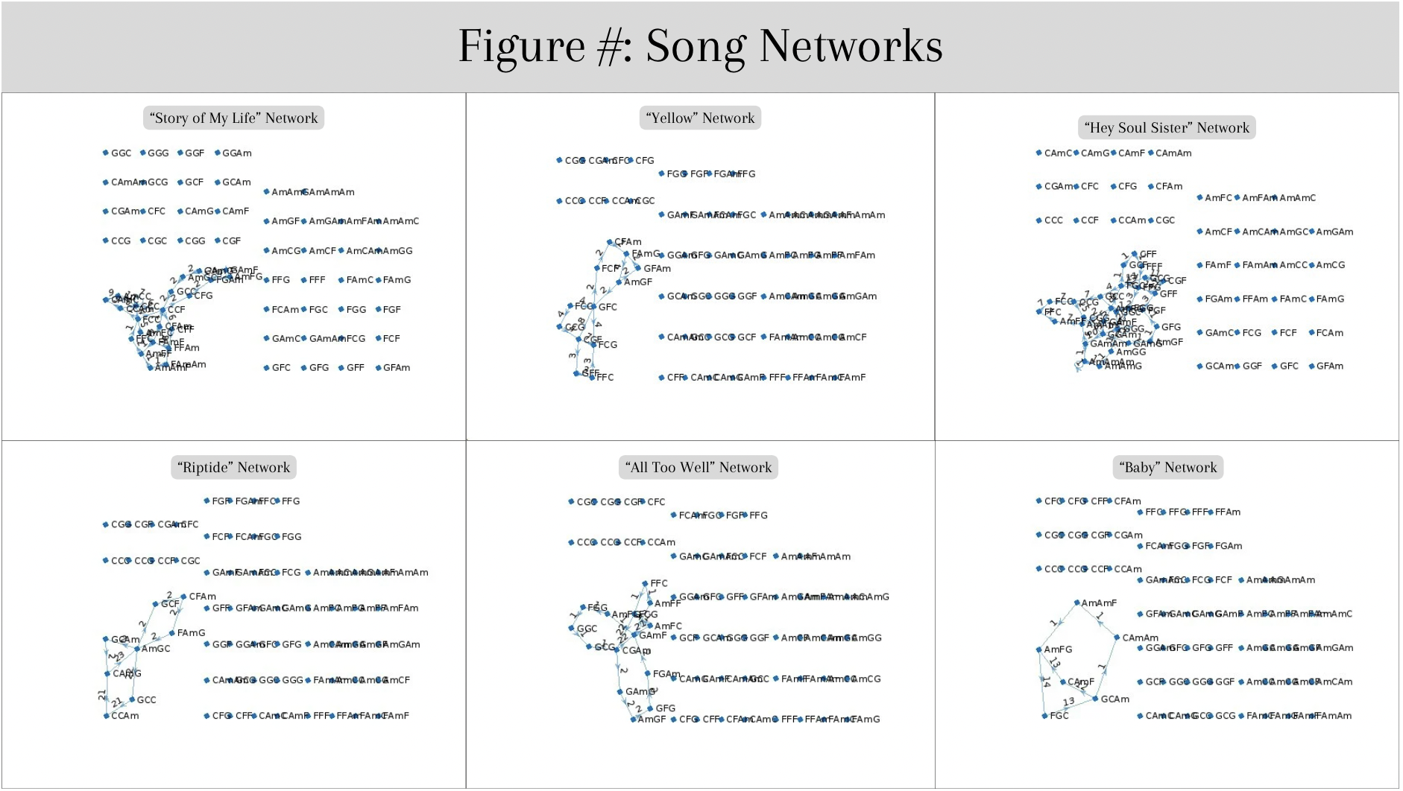

Slide 17
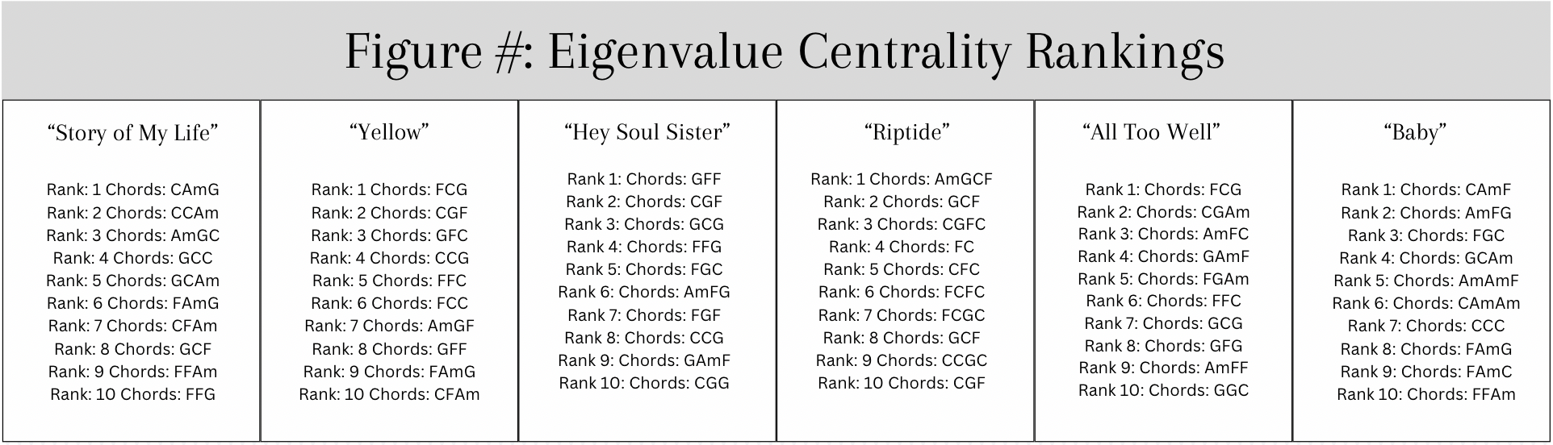
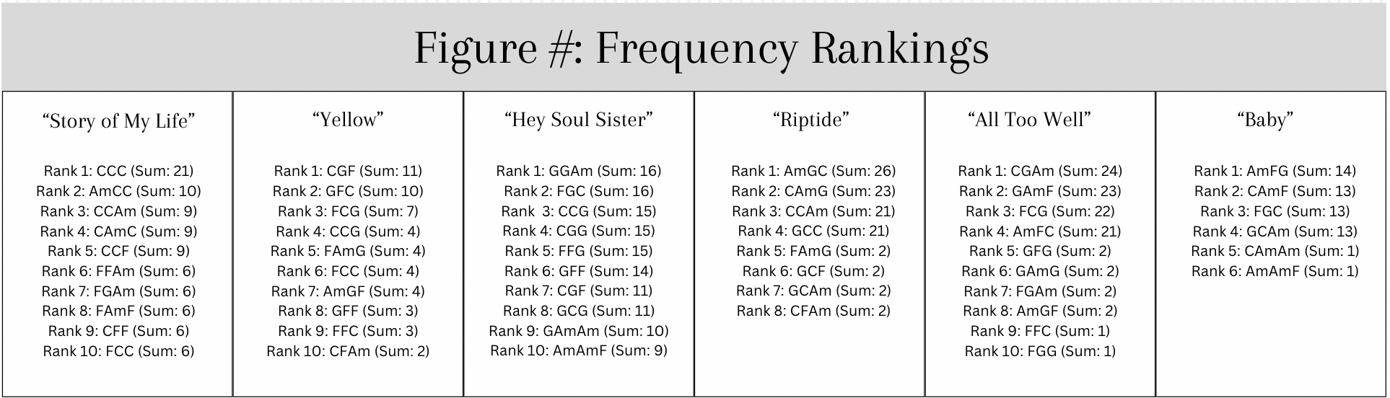

Slide 18
Eigenvalue Centrality & Frequency Analysis
Observation: Certain songs have fewer frequency rankings due to entries with zero sums being disregarded in the Frequency analysis. There is a strong overlap of two or all chords Repetition of specific chord sequences suggests melodic nature of songs.
Example: In "Yellow," both Eigenvalue Centrality and Frequency Rankings share chords like FCG and CGF in both rankings.
Insight: Higher ranked chord sequences reinforce centrality and frequency of nodes in the network. Repetition in these centralities suggests the melodic nature of the songs

Slide 19
Eigenvalue Centrality & Frequency Analysis
Intersection: Eigenvalue centrality and frequency rankings intersect but also show clear distinctions.
Effect of Node Importance: Popular nodes favored in eigenvalue centrality rankings (e.g., GFF in "Hey Soul Sister").
Effect of Chord Sequences: Frequency rankings favor sequences that traverse to any node in the networks (e.g., GGAm in "Hey Soul Sister").
Conclusion: Eigenvalue centrality useful for chord sequences arranged between two others, while frequency useful for sequences preceding a specific sequence. Harmonic arrangement possible between select few sequences

Slide 20
Earth Mover Distance
The Earth Mover's Distance (EMD), or Wasserstein metric, is a distance function defined between probability distributions on a given metric space, which is used to determine how similar two distributions are.
Intuitively, if each distribution is viewed as a unit amount of earth, EMD gives the minimum effort/cost needed to rearrange one pile of earth to match the other exactly.
That’s why we decide to use EMD to compare the similarity of chord progressions in different songs, and we calculate the EMD for each pair of songs to measure the ‘distance’ between the chord progressions.

Slide 21
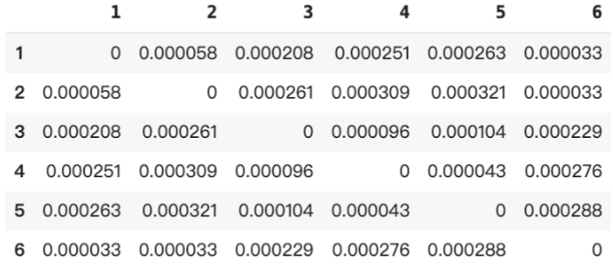
EMD Table
Diagonal entries are zero – it compares each song with itself.
Looking at off-diagonal entries, smaller numbers indicate more similar chord progressions.
For instance, the EMD between songs 2 and 6 is particularly small (0.000033), suggesting they have very similar chord structures. On the other hand, the EMD between songs 2 and 5 is 0.000321, implying a greater difference in their chord progressions.
Therefore, songs with the smallest EMD values are more stylistically close to each other than those with larger values, providing insights into the musical and structural similarities between these pieces.

Slide 22
Dendrogram
Based on the EMD result matrix, we also build up a dendrogram — visually represent the relative similarity between the songs.
In this tree-like diagram, the root represents the point at which all songs are considered in a single cluster, each leaf represents a song, and the branches show how songs are grouped based on the EMD.
The height at which two branches merge represents the EMD between clusters:
the lower the merge point, the more similar the songs are.
We can easily identify which songs are similar to each other in terms of chord progression and how they are grouped into larger clusters.

Slide 23
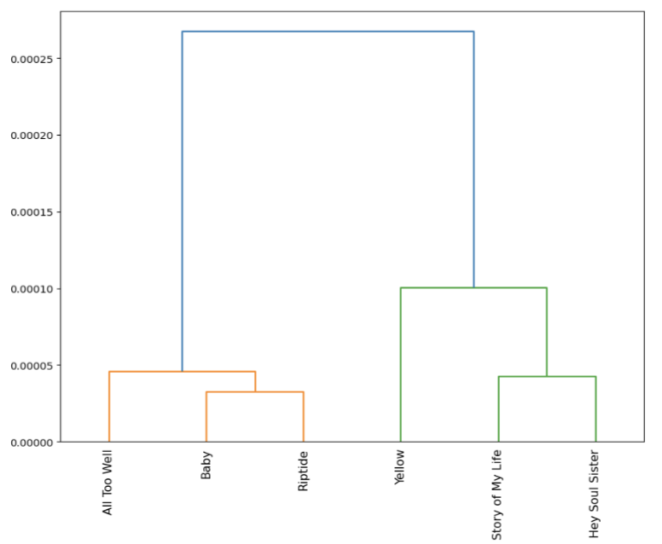
For example, we deduce that Baby and Riptide, as well as Story of My Life and Hey Soul Sister, are more similar compared to other pairs of songs.

Slide 24
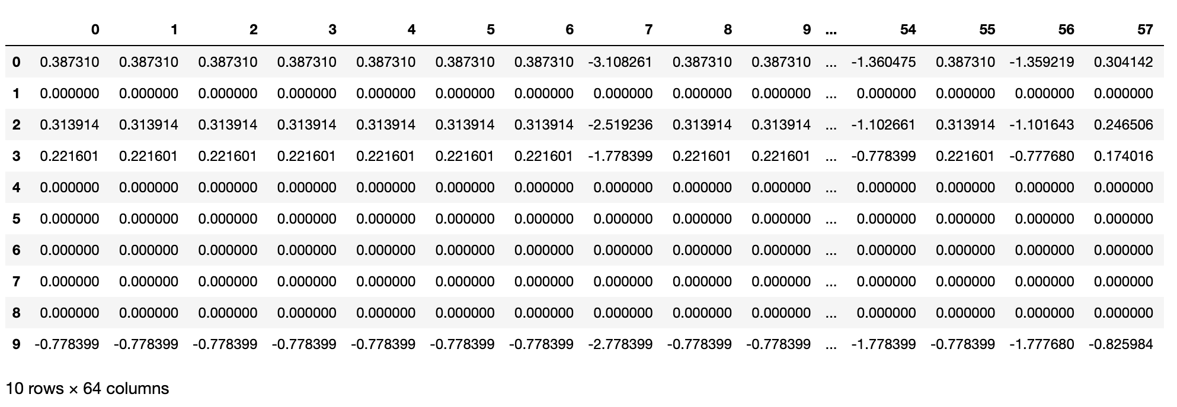
Matrix Multiplication
Identify similarities in song structures
Measures interaction between chord progressions in songs
Adjacency matrices normalized (mean-subtracted, variance-normalized)
Analysis considers both directions of influence
Song A to B, and B to A: matrix multiplication is noncommutative

Slide 25
Matrix Multiplication
Different outcomes for song A to B and B to A transitions
Expected, due to non-commutative matrix multiplication
High positive values indicate strong direct connections; negative values suggest inverse relationships
Non-zero matrix elements indicate common connections or pathways
High values suggest similar connectivity patterns
Low values indicate weaker relationships in similar connectivity patterns

Slide 26
Matrix Multiplication
Baby to Riptide
384 non-zero entries, varied interactions
Strongest positive connection: 61.13 (GAmC to CAmG progression)
Riptide to Baby
512 non-zero entries, more interactions
Strongest positive connection: 4.62 (FAmC to CAmAm progression)
Indicates Riptide's greater impact on Baby, with significant positive and negative connections

Slide 27
Matrix Multiplication
Story of My Life to Hey Soul Sister
1323 non-zero entries
Strongest positive connection: 62.50 (AmFG to GAmF)
Hey Soul Sister to Story of My Life
1827 non-zero entries
Strongest positive connection: 62.38 (FFAm to GCF)
Suggests Hey Soul Sister's substantial influence on Story of My Life

Slide 28
Chord Sequence Generator
Aim: To generate chord sequences using transition matrices and Markov chain principles
Process
Summing and averaging transition matrices from 6 songs
Normalization of average transition matrix to ensure valid chord transitions
End Result
Generating a random walk through the network
Demonstrated with a 30-step chord progression starting from `FCG`
FCGAm FCGAm FCCG GAmFG AmFCG FCFAm FCGAm FCGAm

Slide 29
03
Discussion
You can enter a subtitle here if you need it

Slide 30
Limitation
Chord Simplification
Limited to only 4 chords
Neglects numerous chord variations
Small Dataset
Analysis based on just 6 songs, which may not provide a comprehensive or generalizable understanding of music similarity
Focus on Chord Progression Only
Excludes other crucial musical factors like drumming patterns, rhythm, tempo, arrangement, structure, and song length
Chord Sequence Generator Limitations
The output of the chord sequence generator is not ideal
Lacks the complexity and nuance of real song compositions

Slide 31
Further Work
Expanding the Dataset and Chord Range
Include a larger number of songs and wider variety of chords
Incorporating Additional Musical Elements
Explore other factors affecting music similarity
drumming patterns, rhythm, tempo, arrangement, structure
Enhancing the Chord Sequence Generator
Improve the chord sequence generator to produce more realistic and complex sequences
Integrate additional features like strumming patterns, rhythm, and tempo for more authentic simulation of music composition
Use diffusion model or LLM to have better predictions

Slide 32
04
Music Demo
https://www.musicca.com/chord-player

Slide 33
Thank you!
Further questions?

